Slide 1
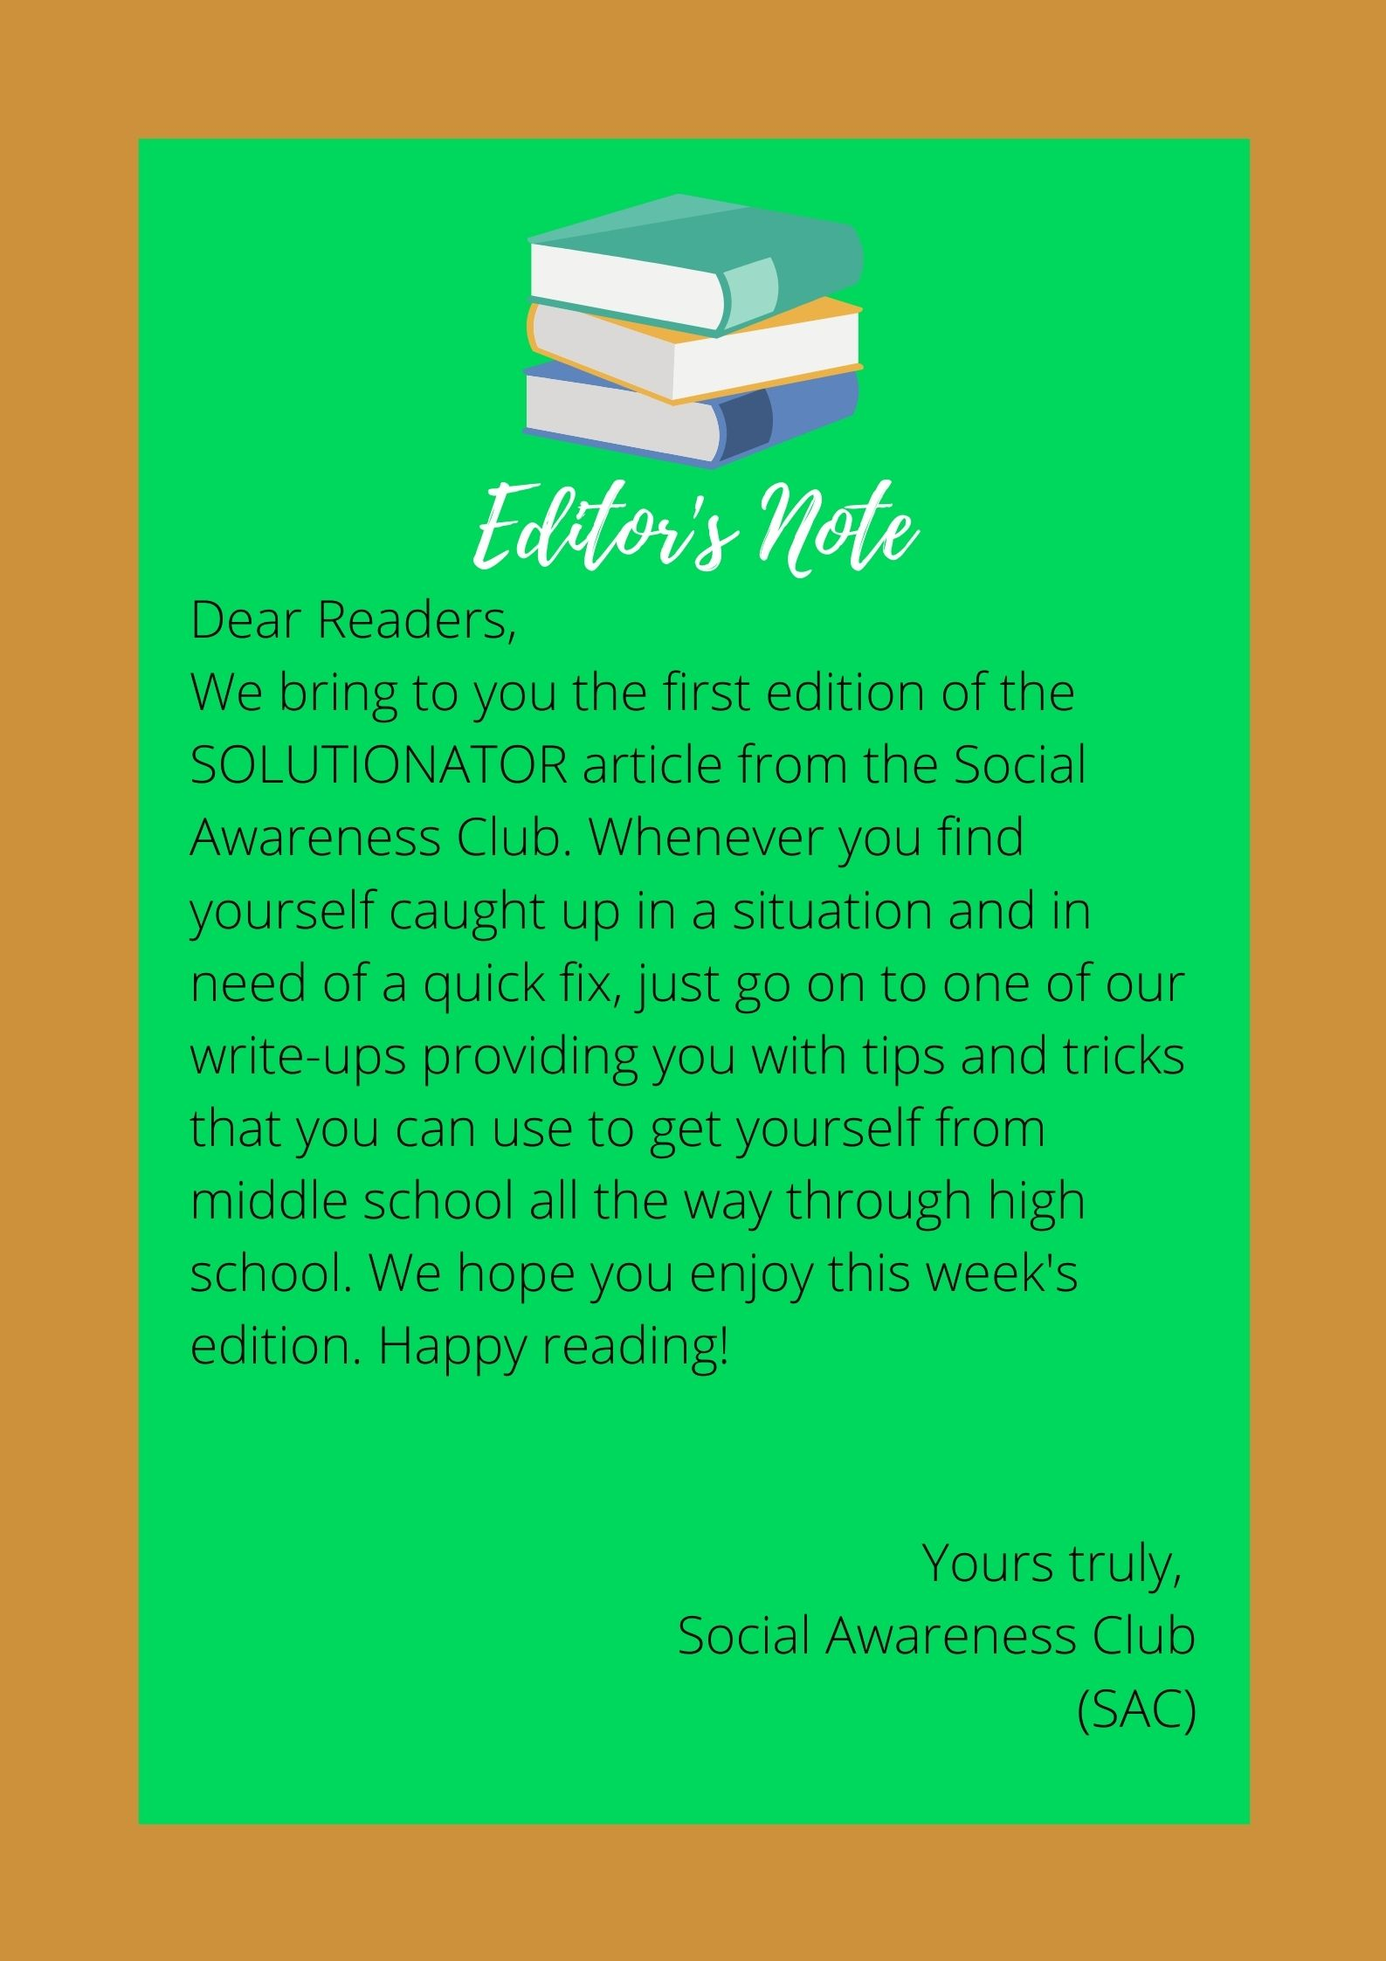

Solutionator
Solutionator
HOME TOPICS HELP & CONTACT ABOUT
HOME TOPICS HELP & CONTACT
The article that gives you the advice you deserve
SAC
Solutionator
By:SAC

Slide 2
Solutionator
HOME TOPICS HELP & CONTACT ABOUT
Solutionator
HOME TOPICS HELP & CONTACT ABOUT
SAC
Subject choice
------------------
------------------
------------------
------------------
------------------

Slide 3
Solutionator
HOME TOPICS HELP & CONTACT ABOUT
Instructions:
In the topics page, you can click onto any of the topics you would like to read on and get started!
Contact:
You can contact us on forms, where you can give us your opinion/ suggestions.
SAC
https://forms.office.com/Pages/ResponsePage.aspx?id=fN7HDmmmJkOtmaysmZPAvlPD4v7UKsRJgqXvvcG93HZUQ0xOUjBNTDlSMVBDRE85SDlHODJMNFZQTC4u

Slide 4
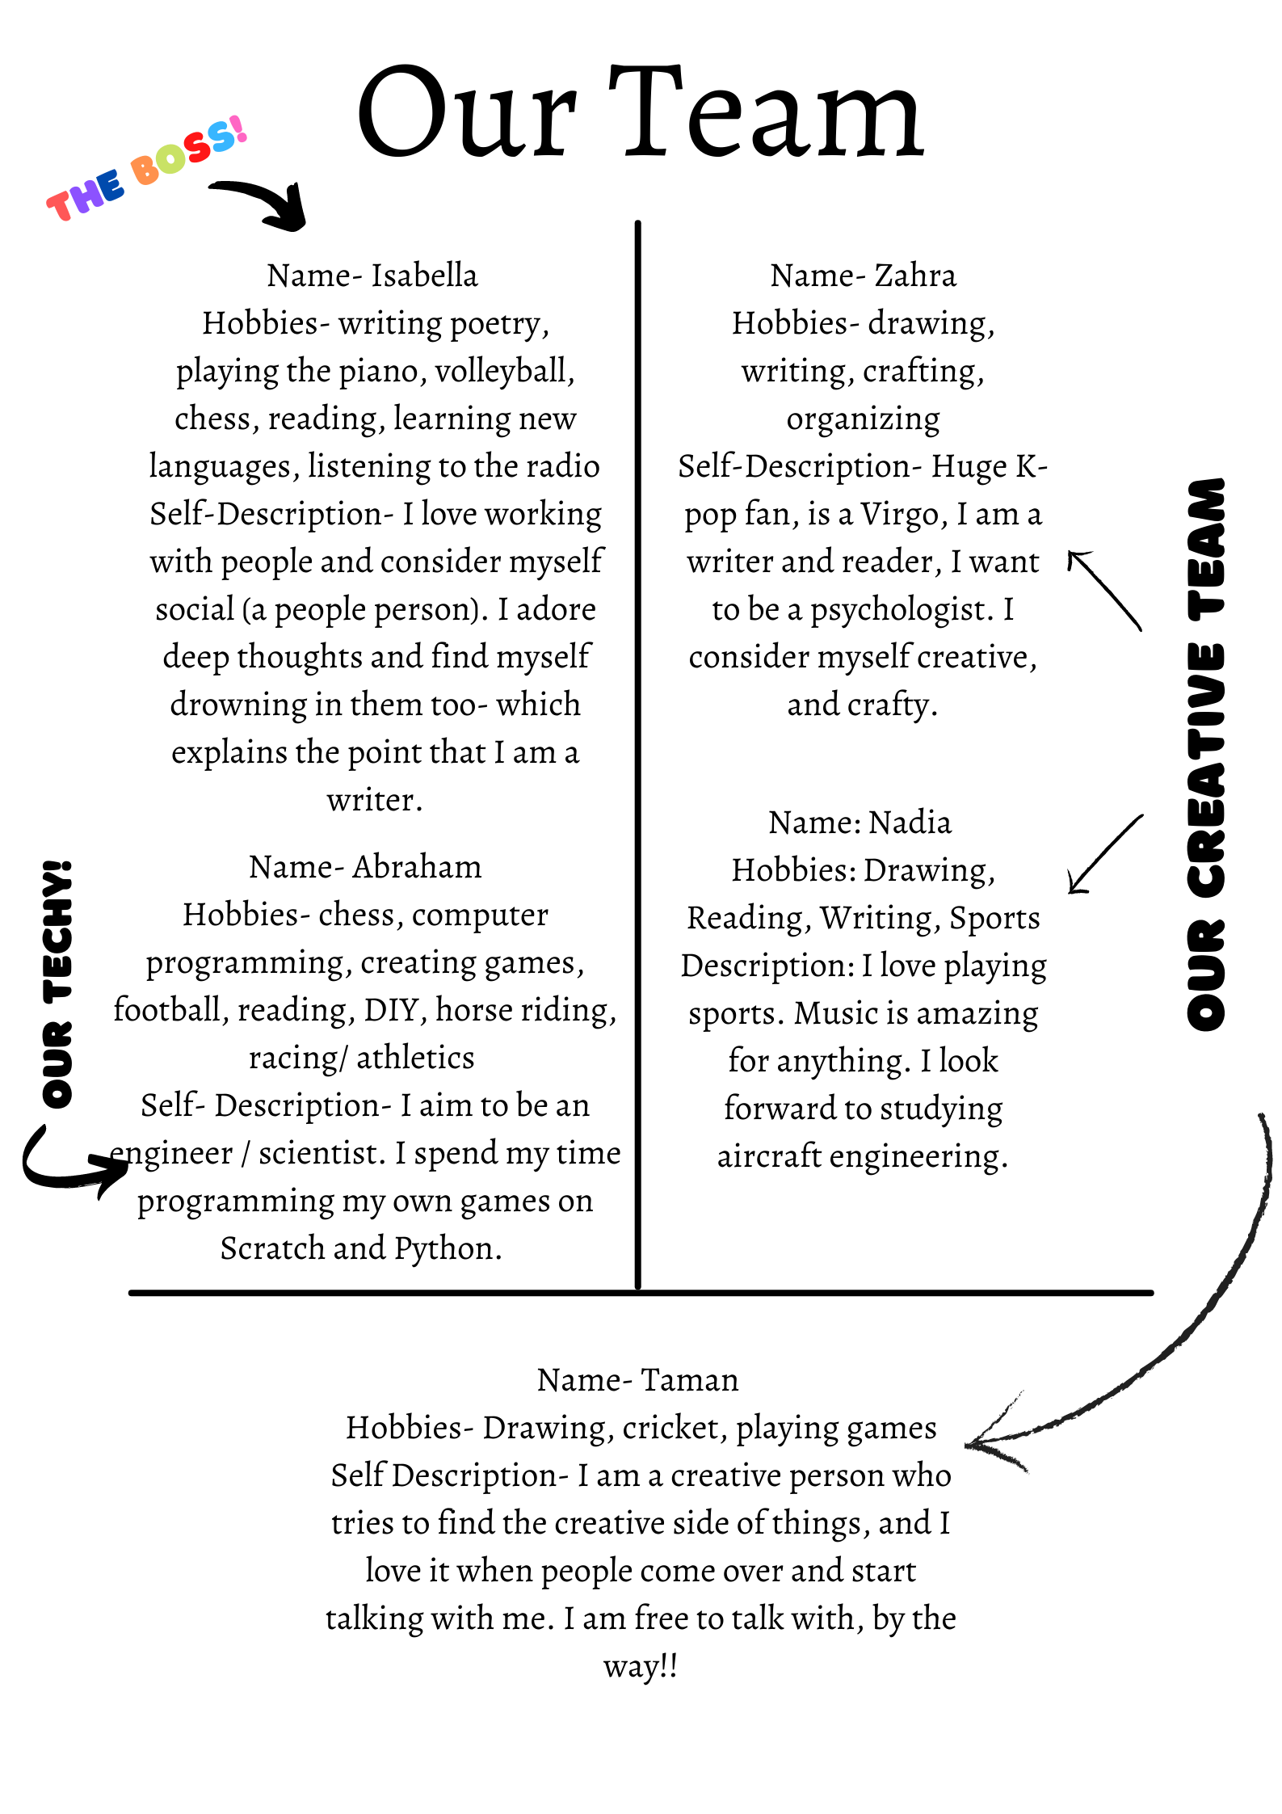
Solutionator
HOME TOPICS HELP & CONTACT ABOUT

Slide 5

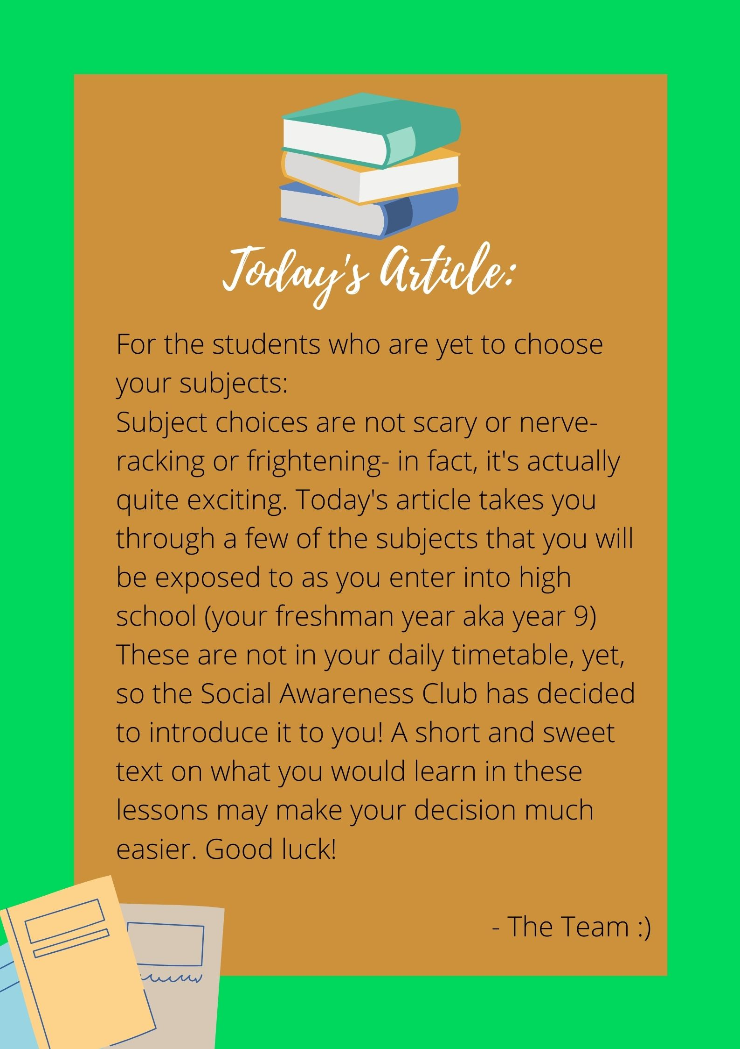
Solutionator

Slide 6


Solutionator

Slide 7


Solutionator

Slide 8


Solutionator

Slide 9


Solutionator

Slide 10


Solutionator

Slide 11


Solutionator

Slide 12

Solutionator
THANK YOU
IF YOU ENJOYED THIS ARTICLE, GIVE IT A THUMBS UP

